Slide 1
Internet Censorship
Security, Privacy, and Consumer Protection Nick Feamster University of Chicago

Slide 2

First Nation in Cyberspace
December 6, 1993
That nation is about to get even bigger as the major commercial computer networks - Prodigy, CompuServe, America Online, GEnie and Delphi Internet Service - begin to dismantle the walls that have separated their private operations from the public Internet. … Most commercial networks now allow electronic mail to pass between their services and the Internet. Delphi… began providing its customers full Internet access earlier this year. America Online…is scheduled to begin offering limited Internet services later this month.
People who uses these new entry points into the Net may be in for a shock. Unlike the family-oriented commercial services, which censor messages they find offensive, the Internet imposes no restrictions. Anybody can start a discussion on any topic and say anything. There have been sporadic attempts by local network managers to crack down on the raunchier discussion groups, but as Internet pioneer John Gilmore puts it, "The Net interprets censorship as damage and routes around it."
Notes:
Consider the date of this publication.
“The Net interprets censorship and routes around it?”
What is the context for this statement?
Do you still agree with it?
What do you think is the biggest threat to this statement today?
Reflect on the trajectory of the Internet, from commercial computer networks to the Internet and back again.

Slide 3
What is Internet censorship?

Slide 4
The What and Why of Internet Censorship
What: Control over what can be accessed, published, viewed
Access: Blocking access to content, applications, services
Publish: Preventing the publication or dissemination of content
View: Blocking access to individual articles
Why: Religious, moral, political, economic …
Religious: Violating the laws of the country
Moral/social: Offending the moral or social sensibilities
Political: Influencing outcomes, preventing collective action
Economic: Influencing trade, increasing productivity

Slide 5
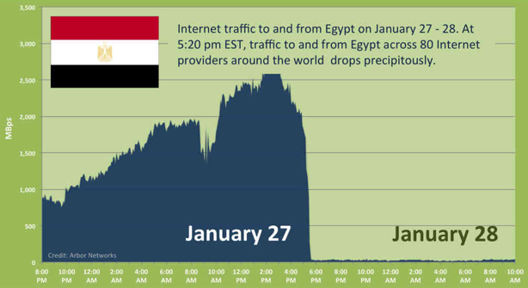
Notes:
2011

Slide 6
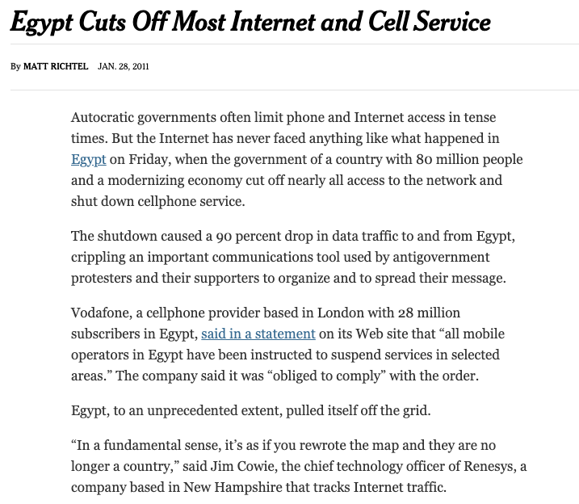
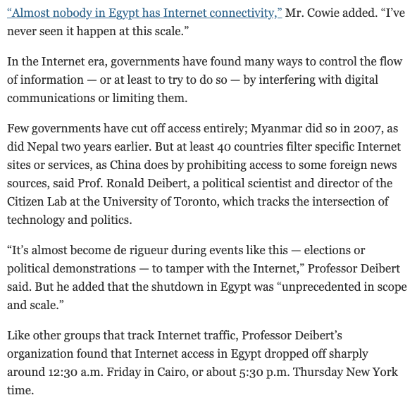

Slide 7
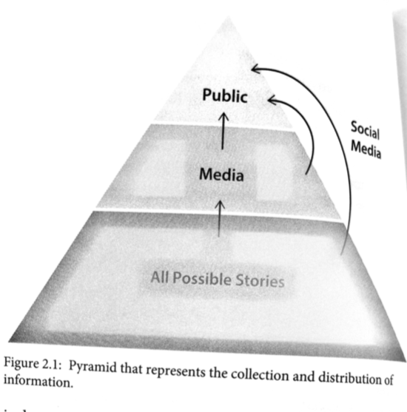
A More “Modern” Theory of Censorship

Slide 8
A Brief History of Internet Censorship
Protocol Filtering
Surveillance
Active Disruption
1990s
2000s
2010s
1994
Internet comes to China
1997
Great Firewall
2006 Golden Shield
2006 Google agrees to censor search results in China
2010 Google stops censoring search results in China
2011 Internet Shutdown in Egypt
2015 Great Cannon
2017 Cloudflare shuts down Daily Stormer, Tor
2018 Google working on Chinese-specific search engine
Notes:
Kiwifarms (2022)

Slide 9
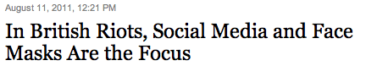

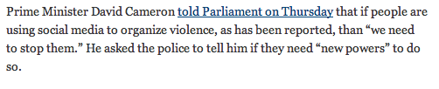



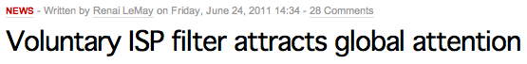
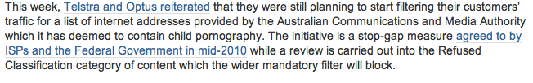
Why Do Countries Censor? (To be continued…)
Political stability
National security
Social values

Slide 10
How widespread is Internet censorship?

Slide 11
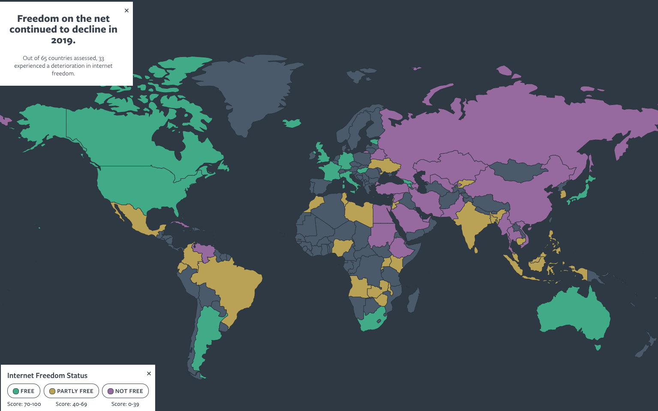

Slide 12
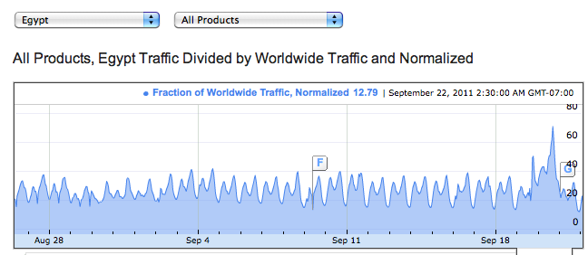
Monitoring Censorship
Herdict: Crowdsourcing reports of Internet censorship
Google Transparency Report: Monitor reachability of online services
ICLab, OONI, Censored Planet: Measurement from endpoints

Slide 13
How is censorship implemented?

Slide 14



Conventional Internet Censorship
Censor
Censor
Firewall
Alice
Block Traffic
Bob
Censored net
Uncensored net
Punish User
Notes:
“Ok so now I’m going to give you a brief primer on Internet censorship and some existing approaches taken to overcome it.”
“Suppose Alice wants to get some content from Bob. If she accesses the Internet from behind a censorship firewall then the censor may monitor or block communication with Bob, and may even punish Alice for trying to communicate with Bob.”

Slide 15
Technical Implementation of Censorship
Protocol interference and manipulation
IP filtering
DNS manipulation and poisoning
TCP connection resets
HTTP(S) redirection
Infrastructure interference
DNS registries/registrars
Certificate authorities
Content delivery networks (CDNs)
Platform interference
Social media
Search engines

Slide 16
Technical Points of Control: Network Paths
Internet Service Providers (ISPs)
Access ISPs
Transit/Backbone ISPs
Content and Publishing Platforms/Portals
Content Delivery Networks (CDNs)
Social Media Platforms
Search Engines and Portals
Client Endpoints
Devices
Applications

Slide 17
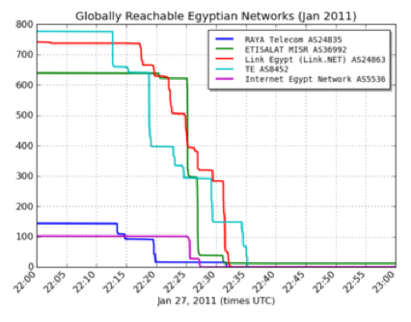
Visualizing the Egypt Internet Shutdown
ISP acts on instructions from a judge, government official, etc.
Filtering: IP address, DNS
Keyword-based: search for keyword in URL
China, Iran, Tunisia have such systems in place
Common: Use of centralized infrastructure (e.g., routing)
Source: Renesys

Slide 18
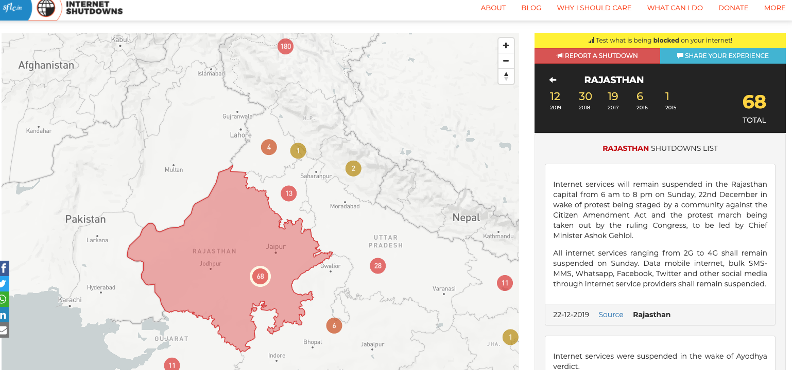
https://internetshutdowns.in/

Slide 19
Non-Technical Forms of Internet Censorship
Self-Censorship
Legal and Policy-Based Mechanisms
Communications Decency Act (Section 230)
Digital Millennium Copyright Act (Section 512)

Slide 20
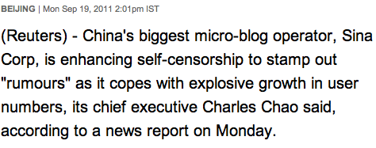
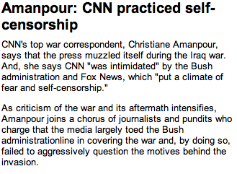
Self-Censorship
Censoring oneself for fear of backlash or retribution
Occurs in many countries
Essentially undocumented

Slide 21
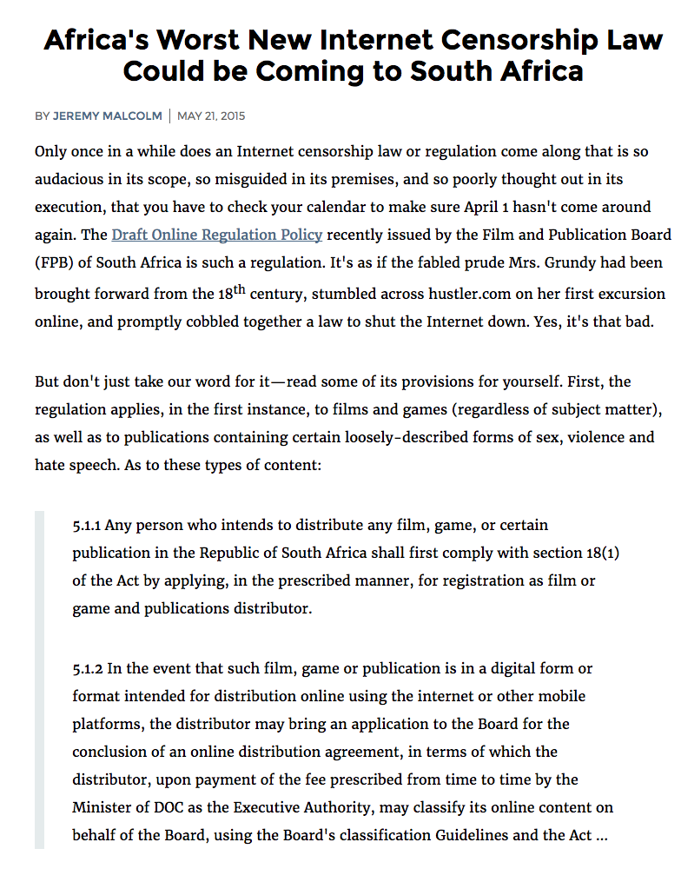
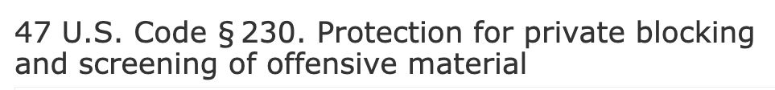
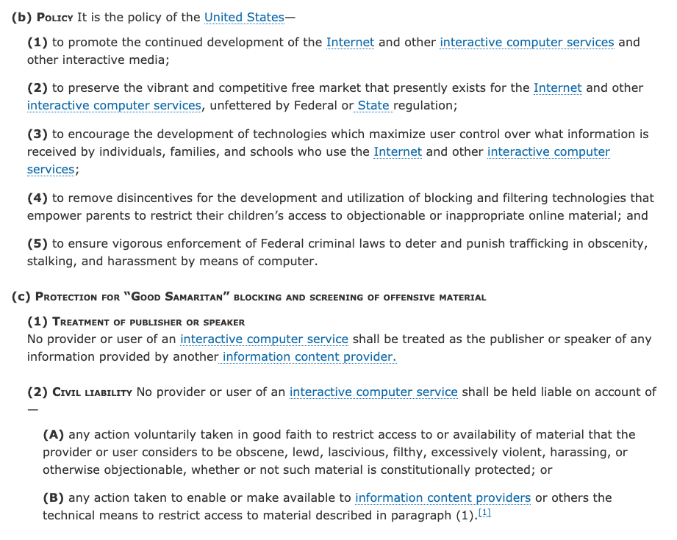
Censorship by Laws: Copyright, etc.

Slide 22
Other Fear and Legal Measures
In 23 countries, a blogger or Internet user was arrested for content posted online
Chinese woman sent to labor camp for satirical Twitter message
Indonesian woman fined for an email complaining about a local hospital
Many countries have instituted bans on Twitter, YouTube or some other online social media service
Source: Freedom on the Net

Slide 23
Internet Censorship is Widespread
Practiced in >60 countries around the world
Many western countries
Several electoral democracies (e.g., S. Korea, Turkey) have significant censorship
YouTube blocked in Turkey for two years
Many North Korean sites blocked in South Korea
Nearly 20 countries have centralized infrastructure for monitoring/blocking
Source: Freedom on the Net

Slide 24
How can censorship be circumvented?

Slide 25



Technical Circumvention Tools
Virtual Private Networks (VPNs)
Anonymous Communication Tools
Secure Messaging

Slide 26
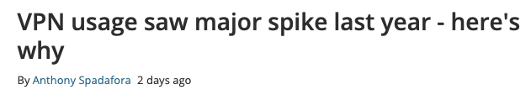
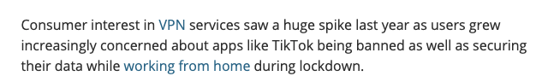
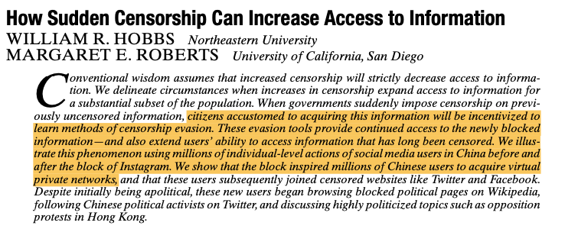

Slide 27
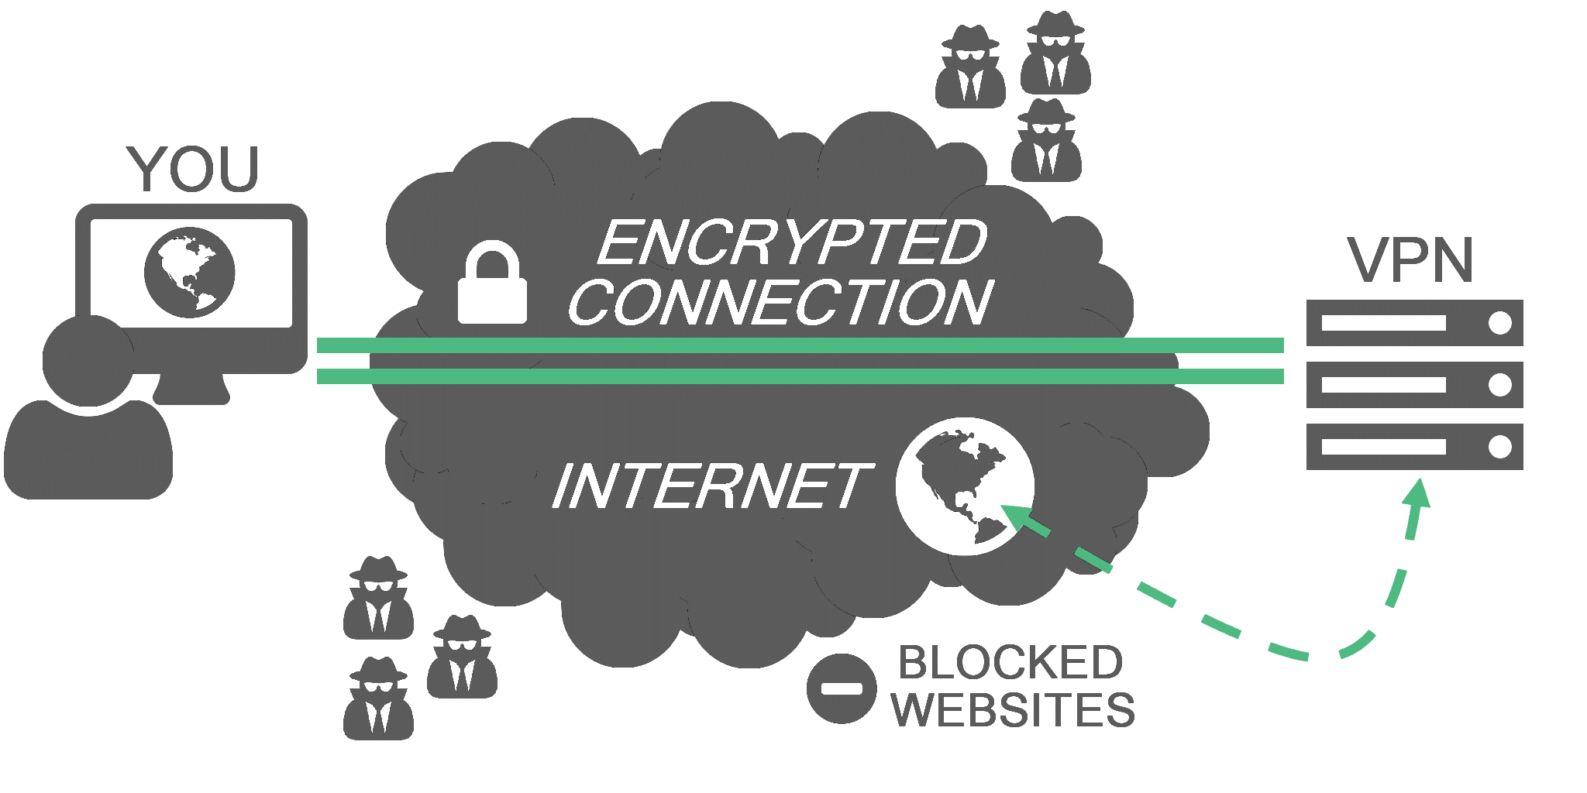
Virtual Private Networks (VPNs)
Encrypt and tunnel user’s traffic through proxy server.

Slide 28
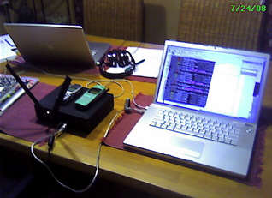
BYOI (Bring Your Own Internet)
Wireless Mesh Networks
OpenBTS (open cell stations)
Open wireless PBX with standard handsets

Slide 29
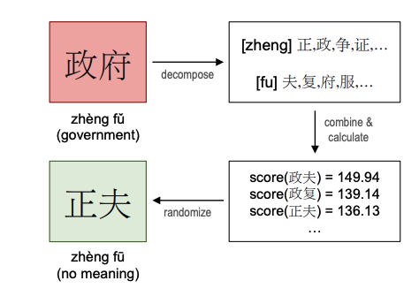
Language-Based Circumvention
Source: Algorithmically Bypassing Censorship on Sina Weibo with Nondeterministic Homophone Substitutions.

Slide 30
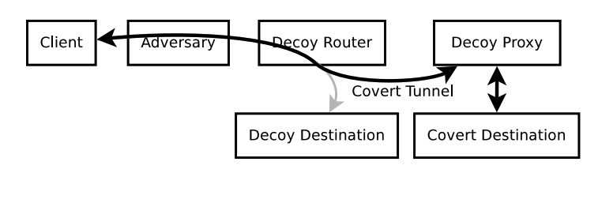
Router-Based Circumvention: Decoy Routing

Slide 31
Internet Censorship and Online Speech Chapter 1.4: Trends, From Protocols to Platforms
Nick Feamster University of Chicago

Slide 32
Trends in Internet Censorship
Information manipulation and control
Centralization of information control infrastructure

Slide 33
Information Manipulation
Sock-puppeting: False appearance of independent speakers
Astroturfing: False appearance of a grassroots movement
Disinformation: Intentionally spreading false information

Slide 34
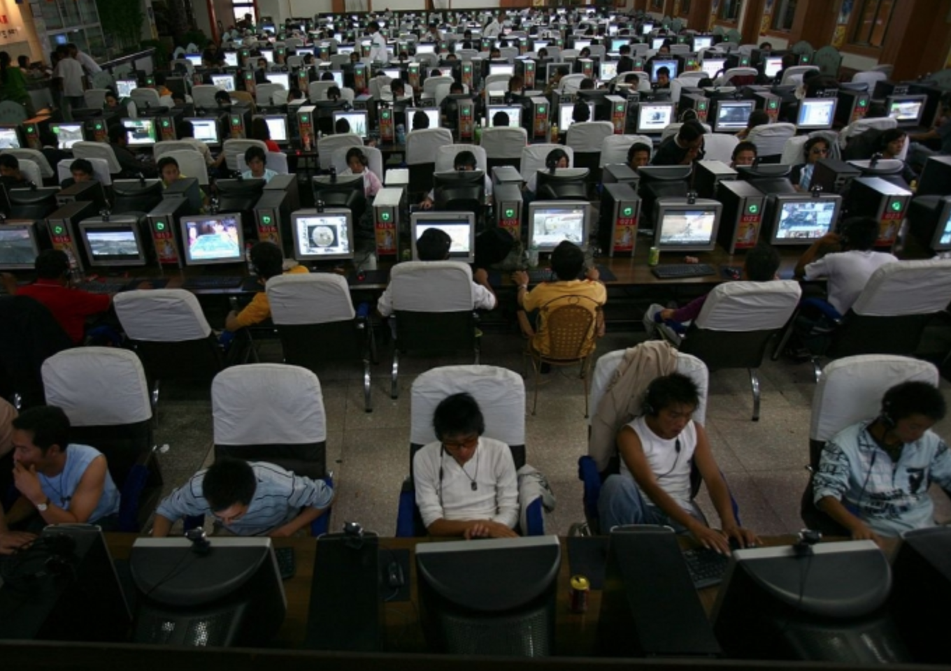
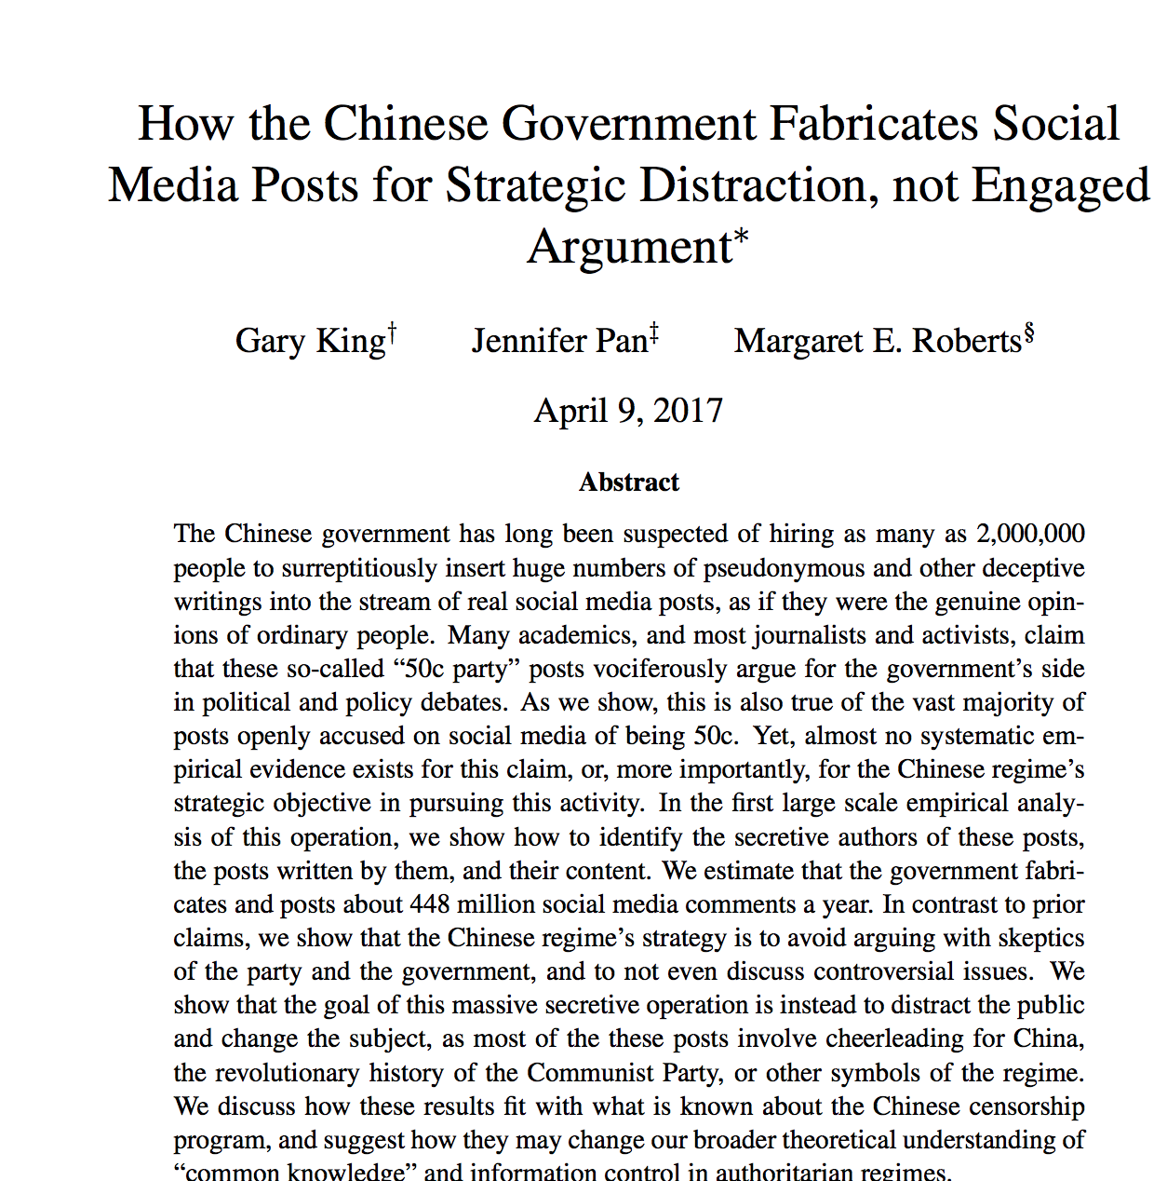

Slide 35
Personalization and “Filter Bubbles”
“A squirrel dying in front of your house may be more relevant to your interests right now than people dying in Africa” – Mark Zuckerberg
Online personalization is creating situations where we only see things that already suit our own tastes.
It can also be exploited by attackers.

Slide 36
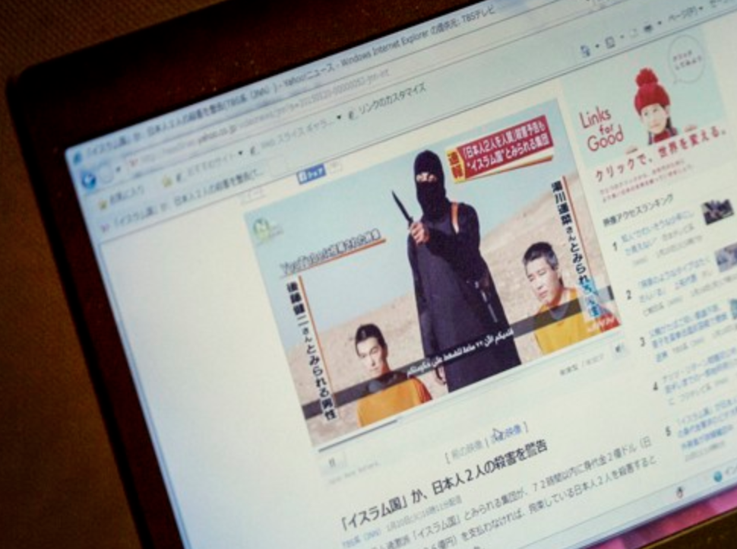
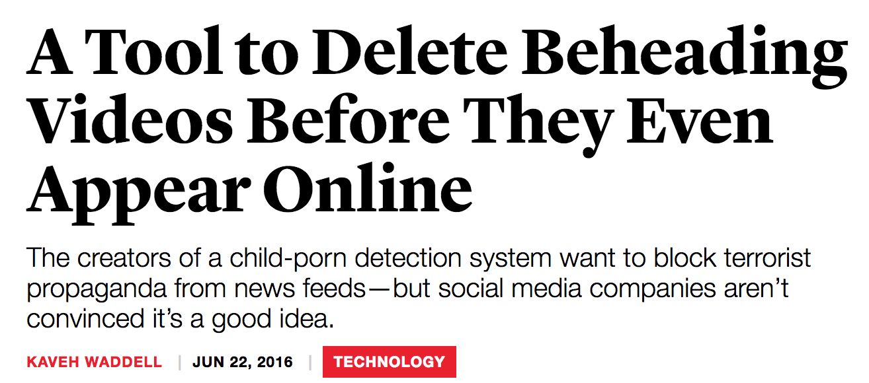
Content Moderation
Notes:
“oh wait… you can take down other stuff, too?”

Slide 37
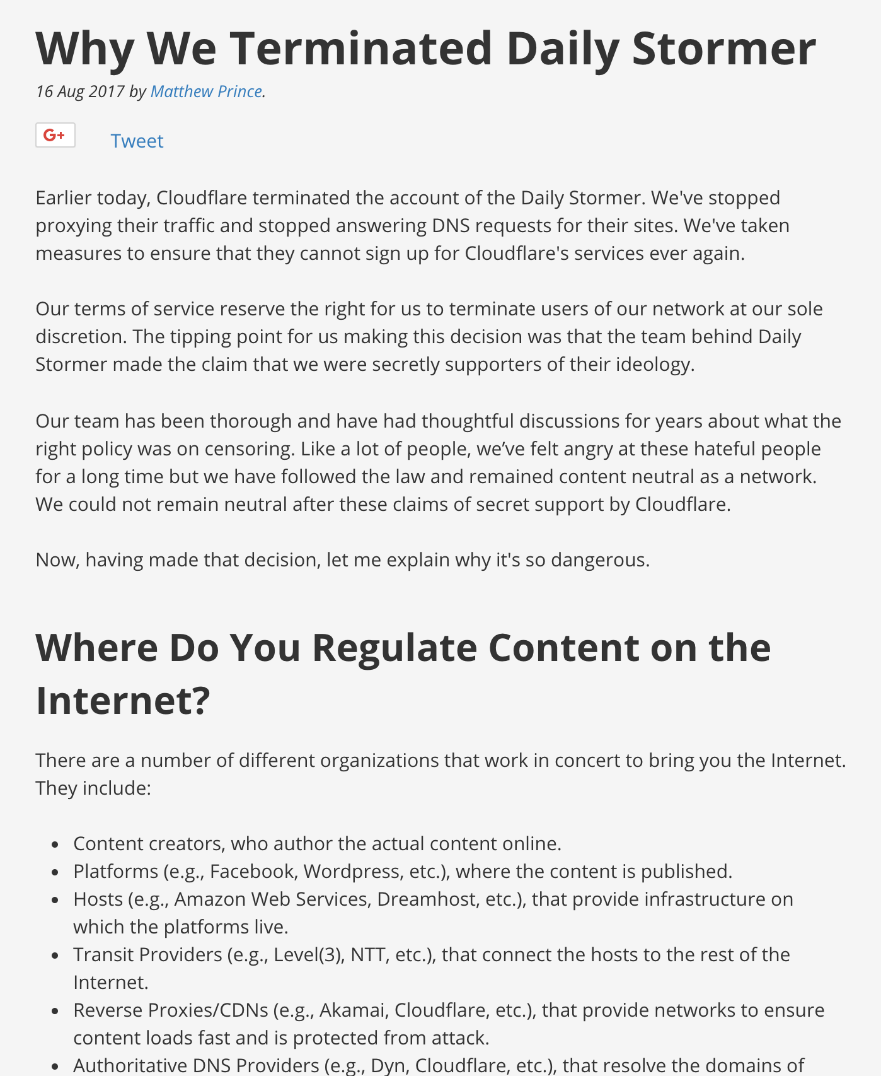

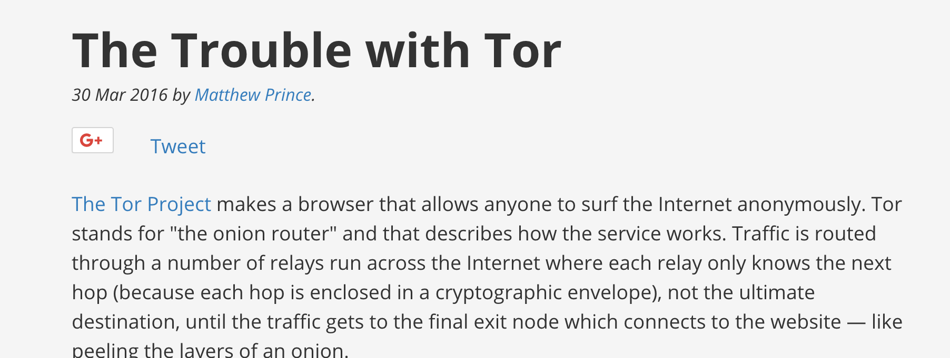
Centralization of Internet content platforms is exacerbating takedown risk.

Slide 38
Roberts’s Taxonomy of Modern Censorship
Fear: Make people afraid to publish or view content
Friction: Make it difficult to find or access content (throttling, burying search results, etc.)
Flooding: Dilute the discourse with additional distracting or irrelevant information.

Slide 39

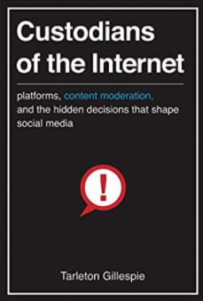

Slide 40
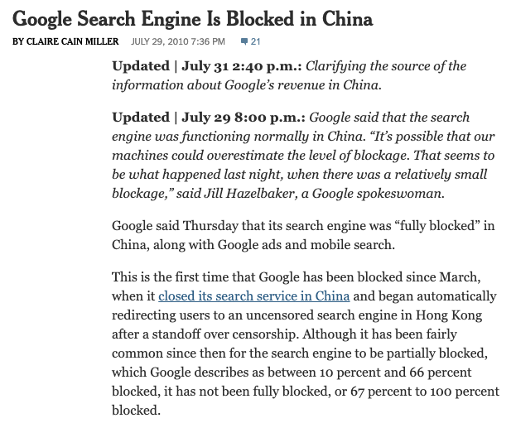
Censorship is not always a Ban or Block
Most censorship methods implemented by China act not as a ban but as a tax on information.
Users must pay more money (or time) if they want to access censored material.
Notes:
China “kicking out” google in 2010 amounted to throttling, making the page load only some of the time (e.g, 75% of the time)

Slide 41
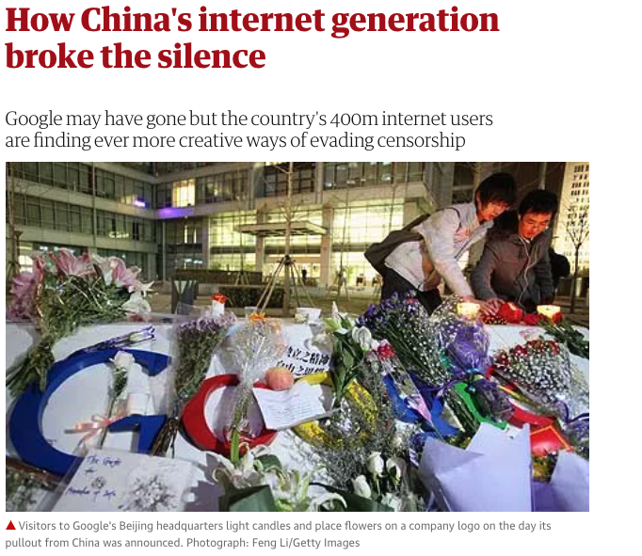
Keyword Filtering Also Evadable
Citizens using homophones, VPNs, etc. to evade censorship.
“Friction”: Censorship is possible to evade, just more difficult.
Notes:
https://www.theguardian.com/world/2010/mar/24/china-internet-generation-censorship

Slide 42
Why do governments attempt to control information when these controls are easily circumvented?

Slide 43
Roberts’s Taxonomy of Modern Censorship
Fear: Make people afraid to publish or view content
Friction: Make it difficult to find or access content (throttling, burying search results, etc.)
Flooding: Dilute the discourse with additional distracting or irrelevant information.

Slide 44
Small Inconveniences are More Effective than Big Barriers
It is often made to look like technical failure (e.g., Internet outage, slower speed)
Sometimes is is hard to definitively identify at all (e.g., search results buried, news story placed on the back pages)
The future of censorship is in the broader lens of information control: The competition for people’s attention.
All of these mechanisms give plausible deniability to the censor.

Slide 45
Porous Censorship is Effective Because It has Holes
Direct repression causes backlash.
Inconveniencing the population is often sufficient.
Small costs of access can have significant effects on the majority
“Customized” approaches can be most effective.
Friction and Flooding work for most.
Fear can be used in cases of more sophisticated citizens/users.

Slide 46
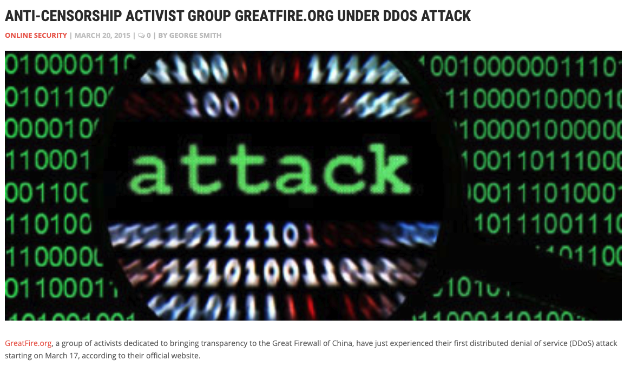
Heavy-Handed Techniques Cause Backlash
Inconvience, “tax” on information is effective for most cases.
The future trends of censorship and information control will (continue to) exploit our limited capacity to process information, our limited attention spans.
Modern definition of censorship: A tax on access to information.

Slide 47
Technical Mechanisms for Friction
Porous Firewalls: VPNs, circumvention software can defeat
Throttling: Slowing down the performance of websites
Manipulation: Making it difficult to find certain content (e.g., manipulating search results)
Alternative Services: Local versions of sites.

Slide 48


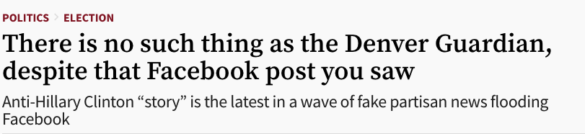
Technical Mechanisms for Flooding
Bots: Accounts to post distracting information (bots could be automated, or even human)
Propaganda and Disinformation:
Websites that contain false or misleading information
Hijacking of hashtags
…

Slide 49
Distraction and Misinformation are Tools of Censorship
Citizens in democracies are vulnerable to these techniques
Attention is limited
When instruments like denial of service are used for political purposes, they become a form of political censorship.

